Slide 1
Design Principals
Part Two

Slide 2
SOLID
An acronym of acronyms!
It recalls in a single word all the most important pricinple of design
SRP
OCP
LSP
ISP
DIP
Single Responsabiity Principle Open Closed Principle
Liskov Substitution Principle Interface Segregation Principle Dependency Inversion Principle

Slide 3
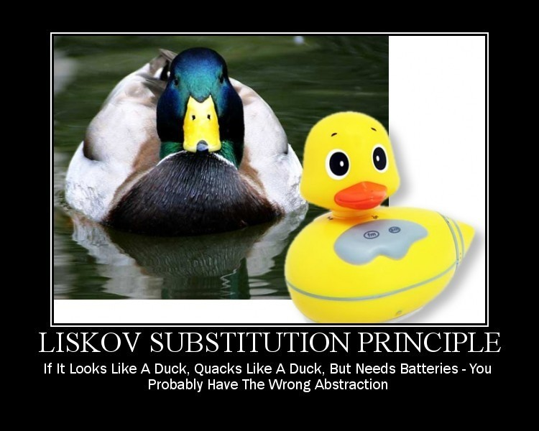

Slide 4
Liskov Substitution Principle
Liskov Substitution Principle states the following:
“in a computer program, if S is a subtype of T, then objects of type T may be replaced with objects of type S (i.e., objects of type S may substitute objects of type T) without altering any of the desirable properties of that program (correctness, task performed, etc.)”.
Barbara Liskov & Jeanette Wing

Slide 5
Liskov Substitution Principle (cont’d)
The Liskov Substitution Principle means that you can inherit from a base class as long as:
you conform to the standards that it sets, such as having the same method name and parameters,
you do not specify any deeper conditions that must be fulfilled,
you return the same type that the base method does and that any Execption that is thrown must match the ones thrown by the base method.

Slide 6

LSP - Meaning
Simply said, any object of some class in an object-oriented program can be replaced by an object of a child class.
The violation of this principle will most likely lead to buggy or difficult to maintain code. They can most usually be recognized by a method that does nothing, or even can’t be implemented.

Slide 7
LSP - Meaning
Bottom line is to make sure that we are not forcing classes together when they really should not be. It is bad design and leads to redundant code or unused methods or creates bugs

Slide 8
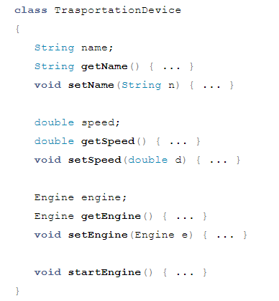
LSP (by example)

Slide 9
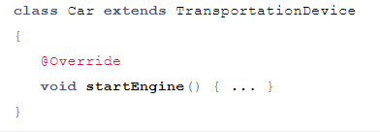
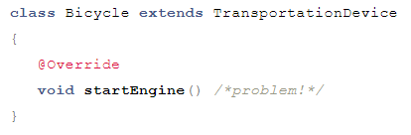
LSP (by example)

Slide 10
LSP (Problem)
Yes, a bicycle is a transportation device, however, it does not have an engine and hence, the method startEngine() cannot be implemented.
These are the kinds of problems that violation of Liskov Substitution Principle leads to, and they can most usually be recognized by a method that does nothing, or even can’t be implemented.
What is the solution to the problem?
(hint: correct inheritance hierarchy)

Slide 11
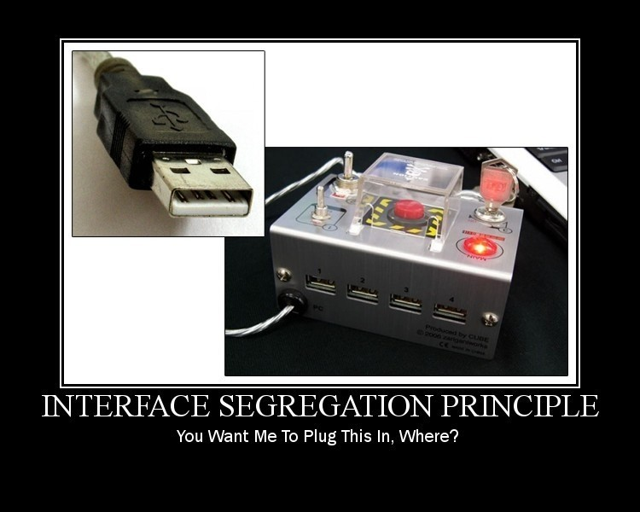

Slide 12
Interface Segregation Principle
The interface-segregation principle (ISP)
states that no client should be forced to depend on methods it does not use.

Slide 13
Interface Segregation Principle
Both the Interface Segregation Principle and Single Responsibility Principle have the same goal:
ensuring small, focused, and highly cohesive software components.
The difference is that the Single Responsibility Principle is concerned with classes, while Interface Segregation Principle is concerned with interfaces.

Slide 14
Interface Segregation Principle
The Interface Segregation Principle advocates segregating a “fat interface” into smaller and highly cohesive interfaces, known as “role interfaces”.
Each “role interface” declares one or more methods for specific behavior. So instead of implementing a “fat interface”, you can implement only those “role interfaces” whose methods are relevant.

Slide 15
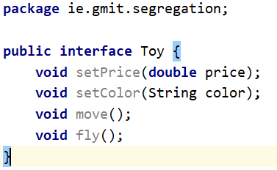
ISP Example
Look at “segregation” package
A class that represents a toy plane can implement the Toy interface and provide implementations of all the interface methods. But, imagine a class that represents a toy house.
Notes:
q

Slide 16
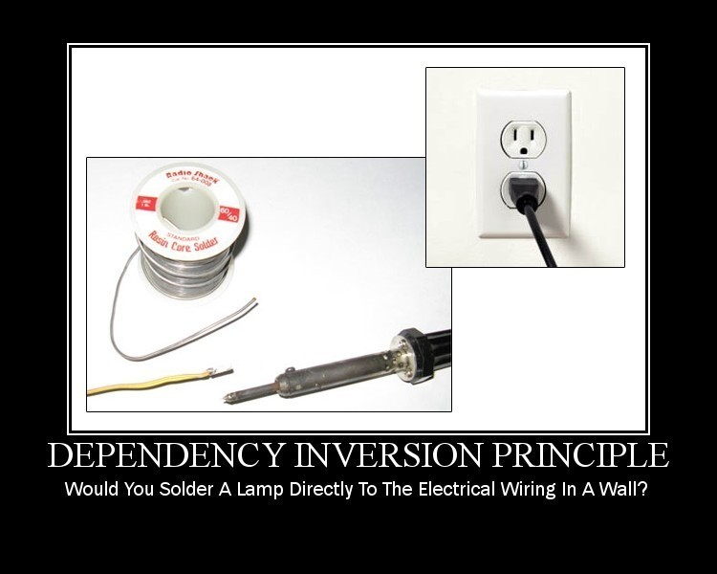
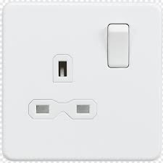

Slide 17
Dependency Inversion Principle
Creating an object of a class using the new operator results in a class being tightly coupled to another class.
Such coupling appears harmless and does not disrupt small programs. But, as you move into enterprise application development, tightly coupled code can lead to serious adverse consequences.

Slide 18
Dependency Inversion Principle
When one class knows explicitly about the design and implementation of another class, changes to one class raise the risk of breaking the other class.
To avoid such problems, you should write “good code” that is loosely coupled, and to support this you can turn to the Dependency Inversion Principle.

Slide 19
Dependency Inversion Principle
High-level modules should not depend on low-level modules. Both should depend on abstractions.
Abstractions should not depend on details. Details should depend on abstractions.”

Slide 20
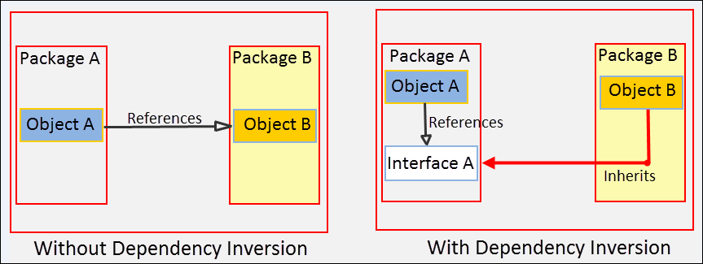
DIP?

Slide 21
DIP?
Both Object A and Object B now depends on Interface A, the abstraction.
It inverted the dependency that existed from Object A to Object B into Object B being dependent on the abstraction (Interface A).

Slide 22
Example – DIP Violation
On Github

Slide 23
Example – DIP Violation
A switch should not be tied to a bulb. It should be able to turn on and off other appliances and devices too, say a radio, a TV etc.
Now, imagine the modifications we will require in the ElectricSocketWithSwitch class each time we add a new appliance or device!
We can conclude that our design is flawed and we need to revisit it by following the Dependency Inversion Principle.

Slide 24
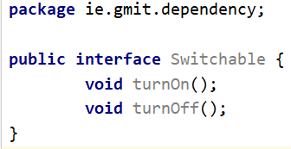
Use Abstraction
We will write an abstraction in the form of an interface called Switchable.
From now on, any switchable devices in the application can implement this interface and provide their own functionality. Our ElectricSocketWithSwitch class will also depend on this interface

Slide 25
Use Abstraction
We will write an abstraction in the form of an interface called Switchable.
From now on, any switchable devices in the application can implement this interface and provide their own functionality. Our ElectricSocketWithSwitch class will also depend on this interface

Slide 26
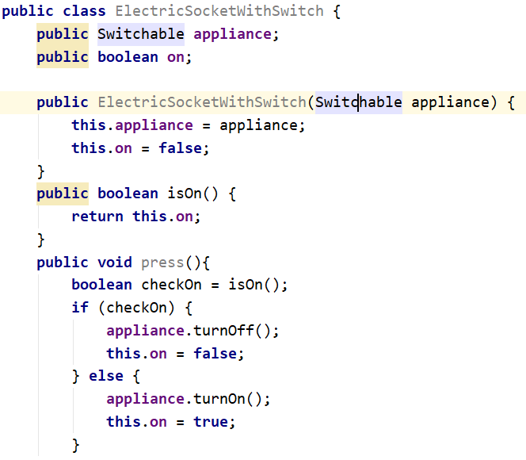
Using Abstraction

Slide 27
Conclusion
The single responsibility principle states that a class (or some other module) should only have one responsibility i.e. one reason to change.
The open/closed states that software entities should be open for extension, but closed for modification.
The Liskov substitution principle - objects in a program should be replaceable with instances of their subtypes without altering the correctness of that program.
The interface segregation principle states that many client-specific interfaces are better than one general-purpose interface.
The dependency inversion principle could be summed up in this sentence: “Depend upon abstractions. Do not depend upon concretions”.

